Slide 1
Galaxy S9 and Android Pie
Final Project

Slide 2
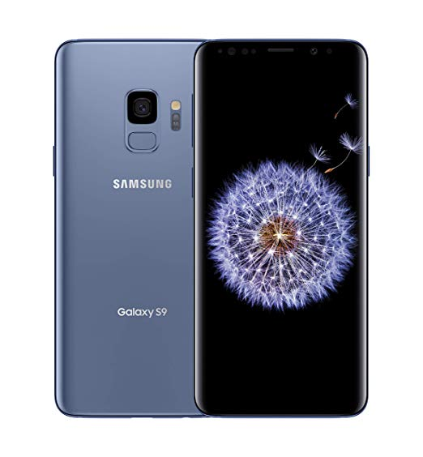
Galaxy S9
Released March 16, 2018
Runs Android 8.0 “Oreo” by defauly
Currently runs Android 9.0 “Pie” with One UI as an overlay
The regular and “plus” variant have 4 GB and 6 GB of RAM respectively
Slot for removable storage microSD card

Slide 3
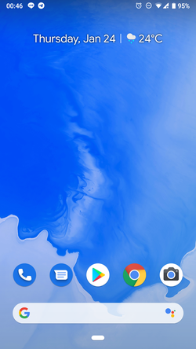

Android Pie
Public release on August 6, 2018
Latest Release 9.0.0 on March 29, 2019
Current supported Android OS
Samsung devices use an interface called “One UI” that has all the same Pie features while also tweaking the position of buttons/toggles, built-in dark mode, its own apps, and custom UI

Slide 4
Android File System Structure
Uses ext4, a journaled file system based on Linux
Google announced in 2010 December that it would use ext4 instead of YAFFS for android 2.3 and newer
If rooted, the partition identifier is 0x83 (since it is ext4)
Directory contents are formatted as a linked list, hashed binary-tree
Uses a structure similar to the NTFS bitmap to track bad blocks

Slide 5
Android File System Structure
Several partitions exist on the device
Boot: kernel image and RAM disk
System: Android framework internal files
Recovery: stores recovery image
Cache: for caching ;)
Metadata: according to Google’s Dev guide, this is for devices that are encrypted and greater than 16 MB in size
Userdata: the forensic goldmine, contains all user installed applications and data, as well as customization data
Applications are sandboxed unless given permissions otherwise
They each have their own folder where they can store their own data such as caches, images, configurations, and databases

Slide 6
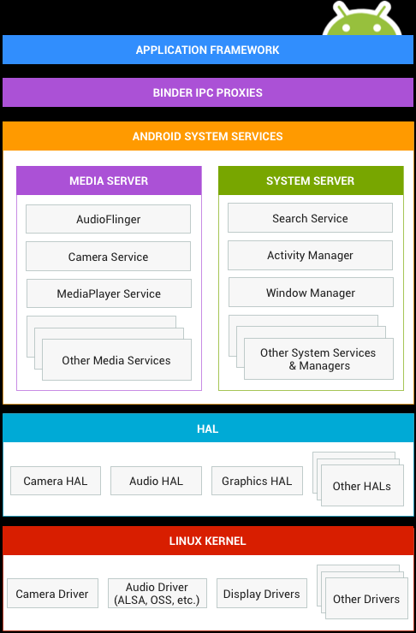
Android Architecture
We usually interface with the Application framework, as the rest of it is hidden even from application developers
High level APIs and applications use the Binder proxies to interact with lower level system services
Android is built on top of Linux

Slide 7
How is application data stored?
Lots of third-party applications available
Messaging alone has: WhatsApp, WeChat, Facebook Messanger, etc.
Data is stored in folders
Generally named of the format “com.android.providers.contacts” for example
Key-value pairs
Databases
Generally SQLite

Slide 8
How do we acquire data?
Root the device and pull a full physical
Will wipe the device, will trip the KNOX counter (i.e. void the warranty)
Device may already be rooted
File System and/or Logical Acquisition
Need to know password
Acquire SIM and microSD card separately
Consider searching for backups

Slide 9
Forensic Tools for Acquisition
UFED 4PC (Cellebrite)
Magnet Axiom
Blacklight
Oxygen
XRY by MSAB

Slide 10
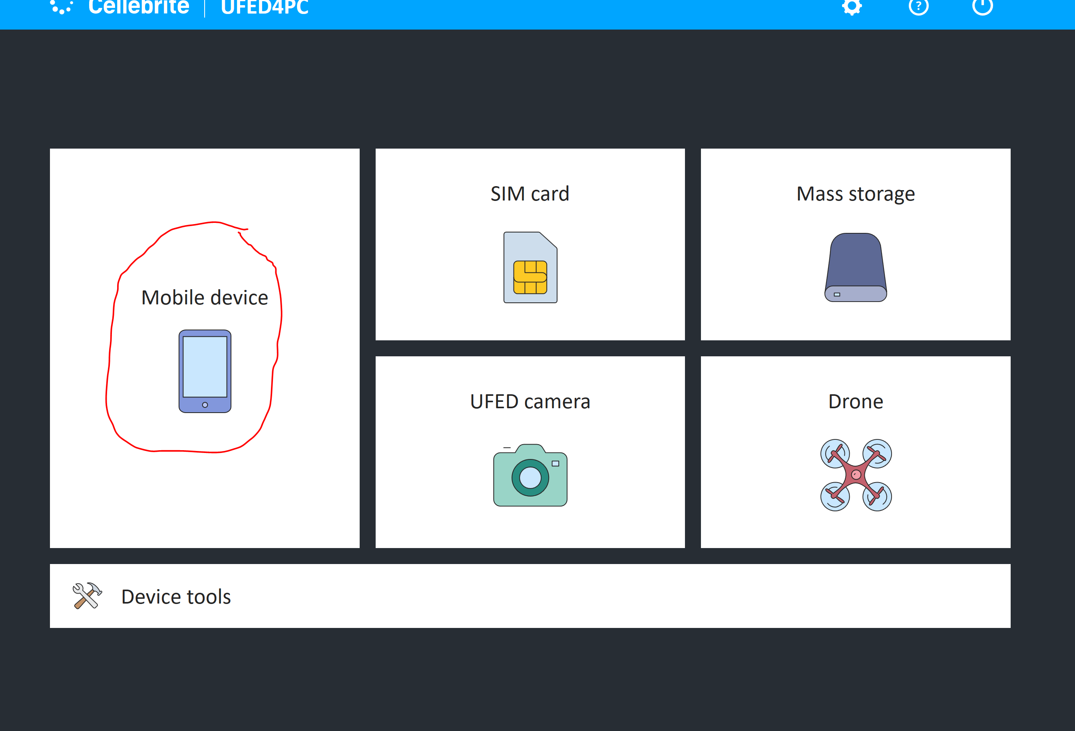
UFED 4PC

Slide 11
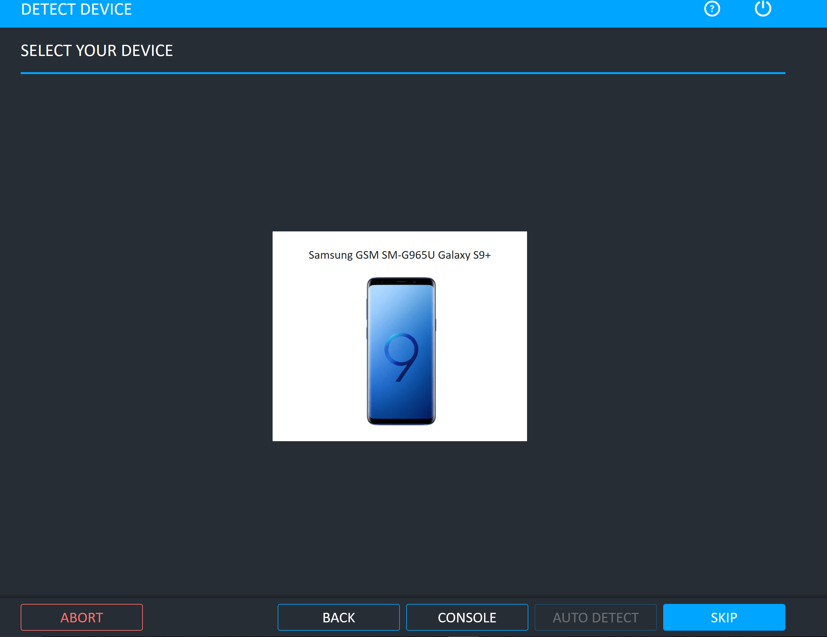
UFED 4PC

Slide 12
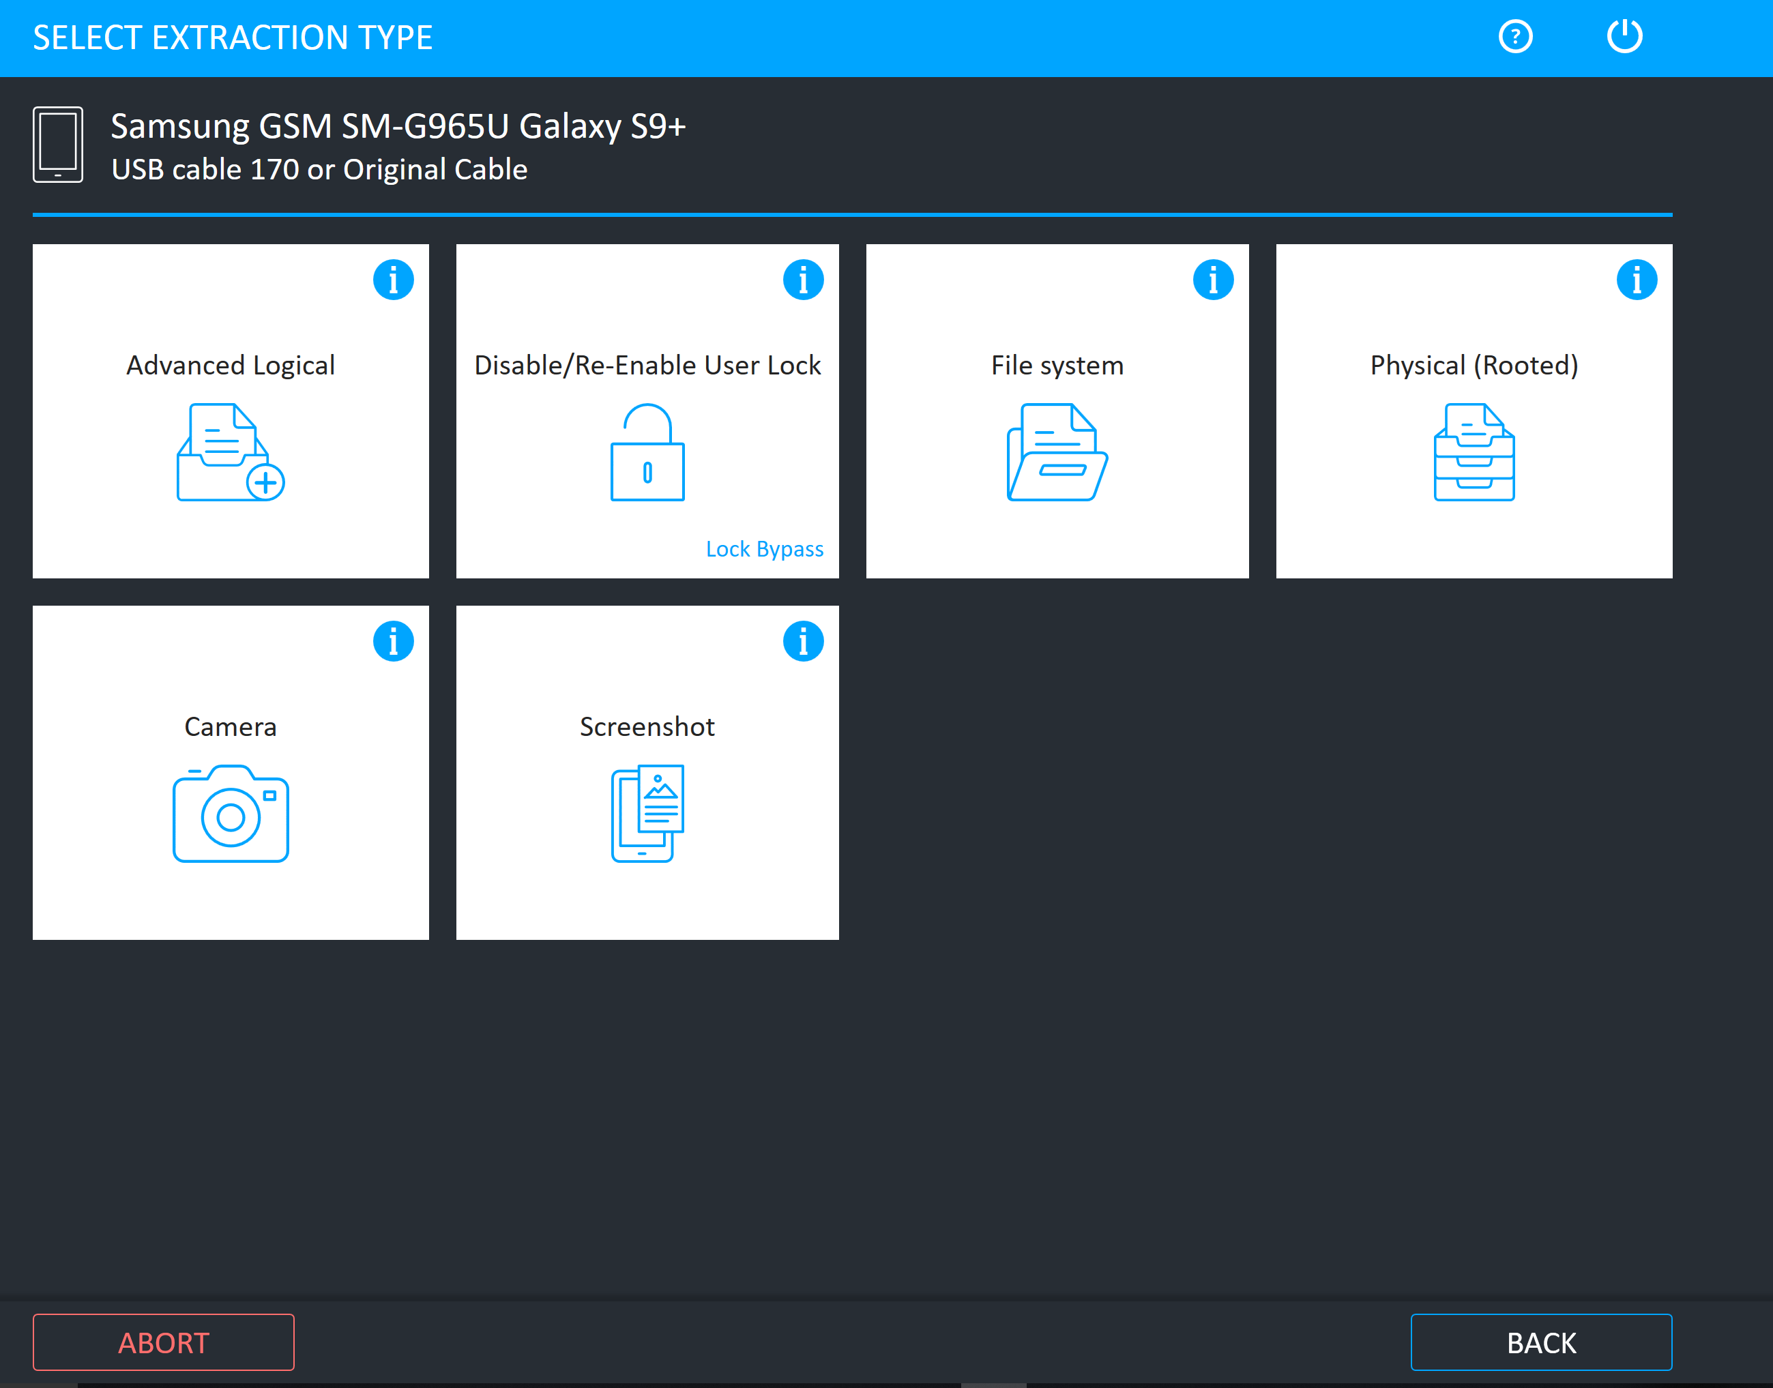
UFED 4PC

Slide 13
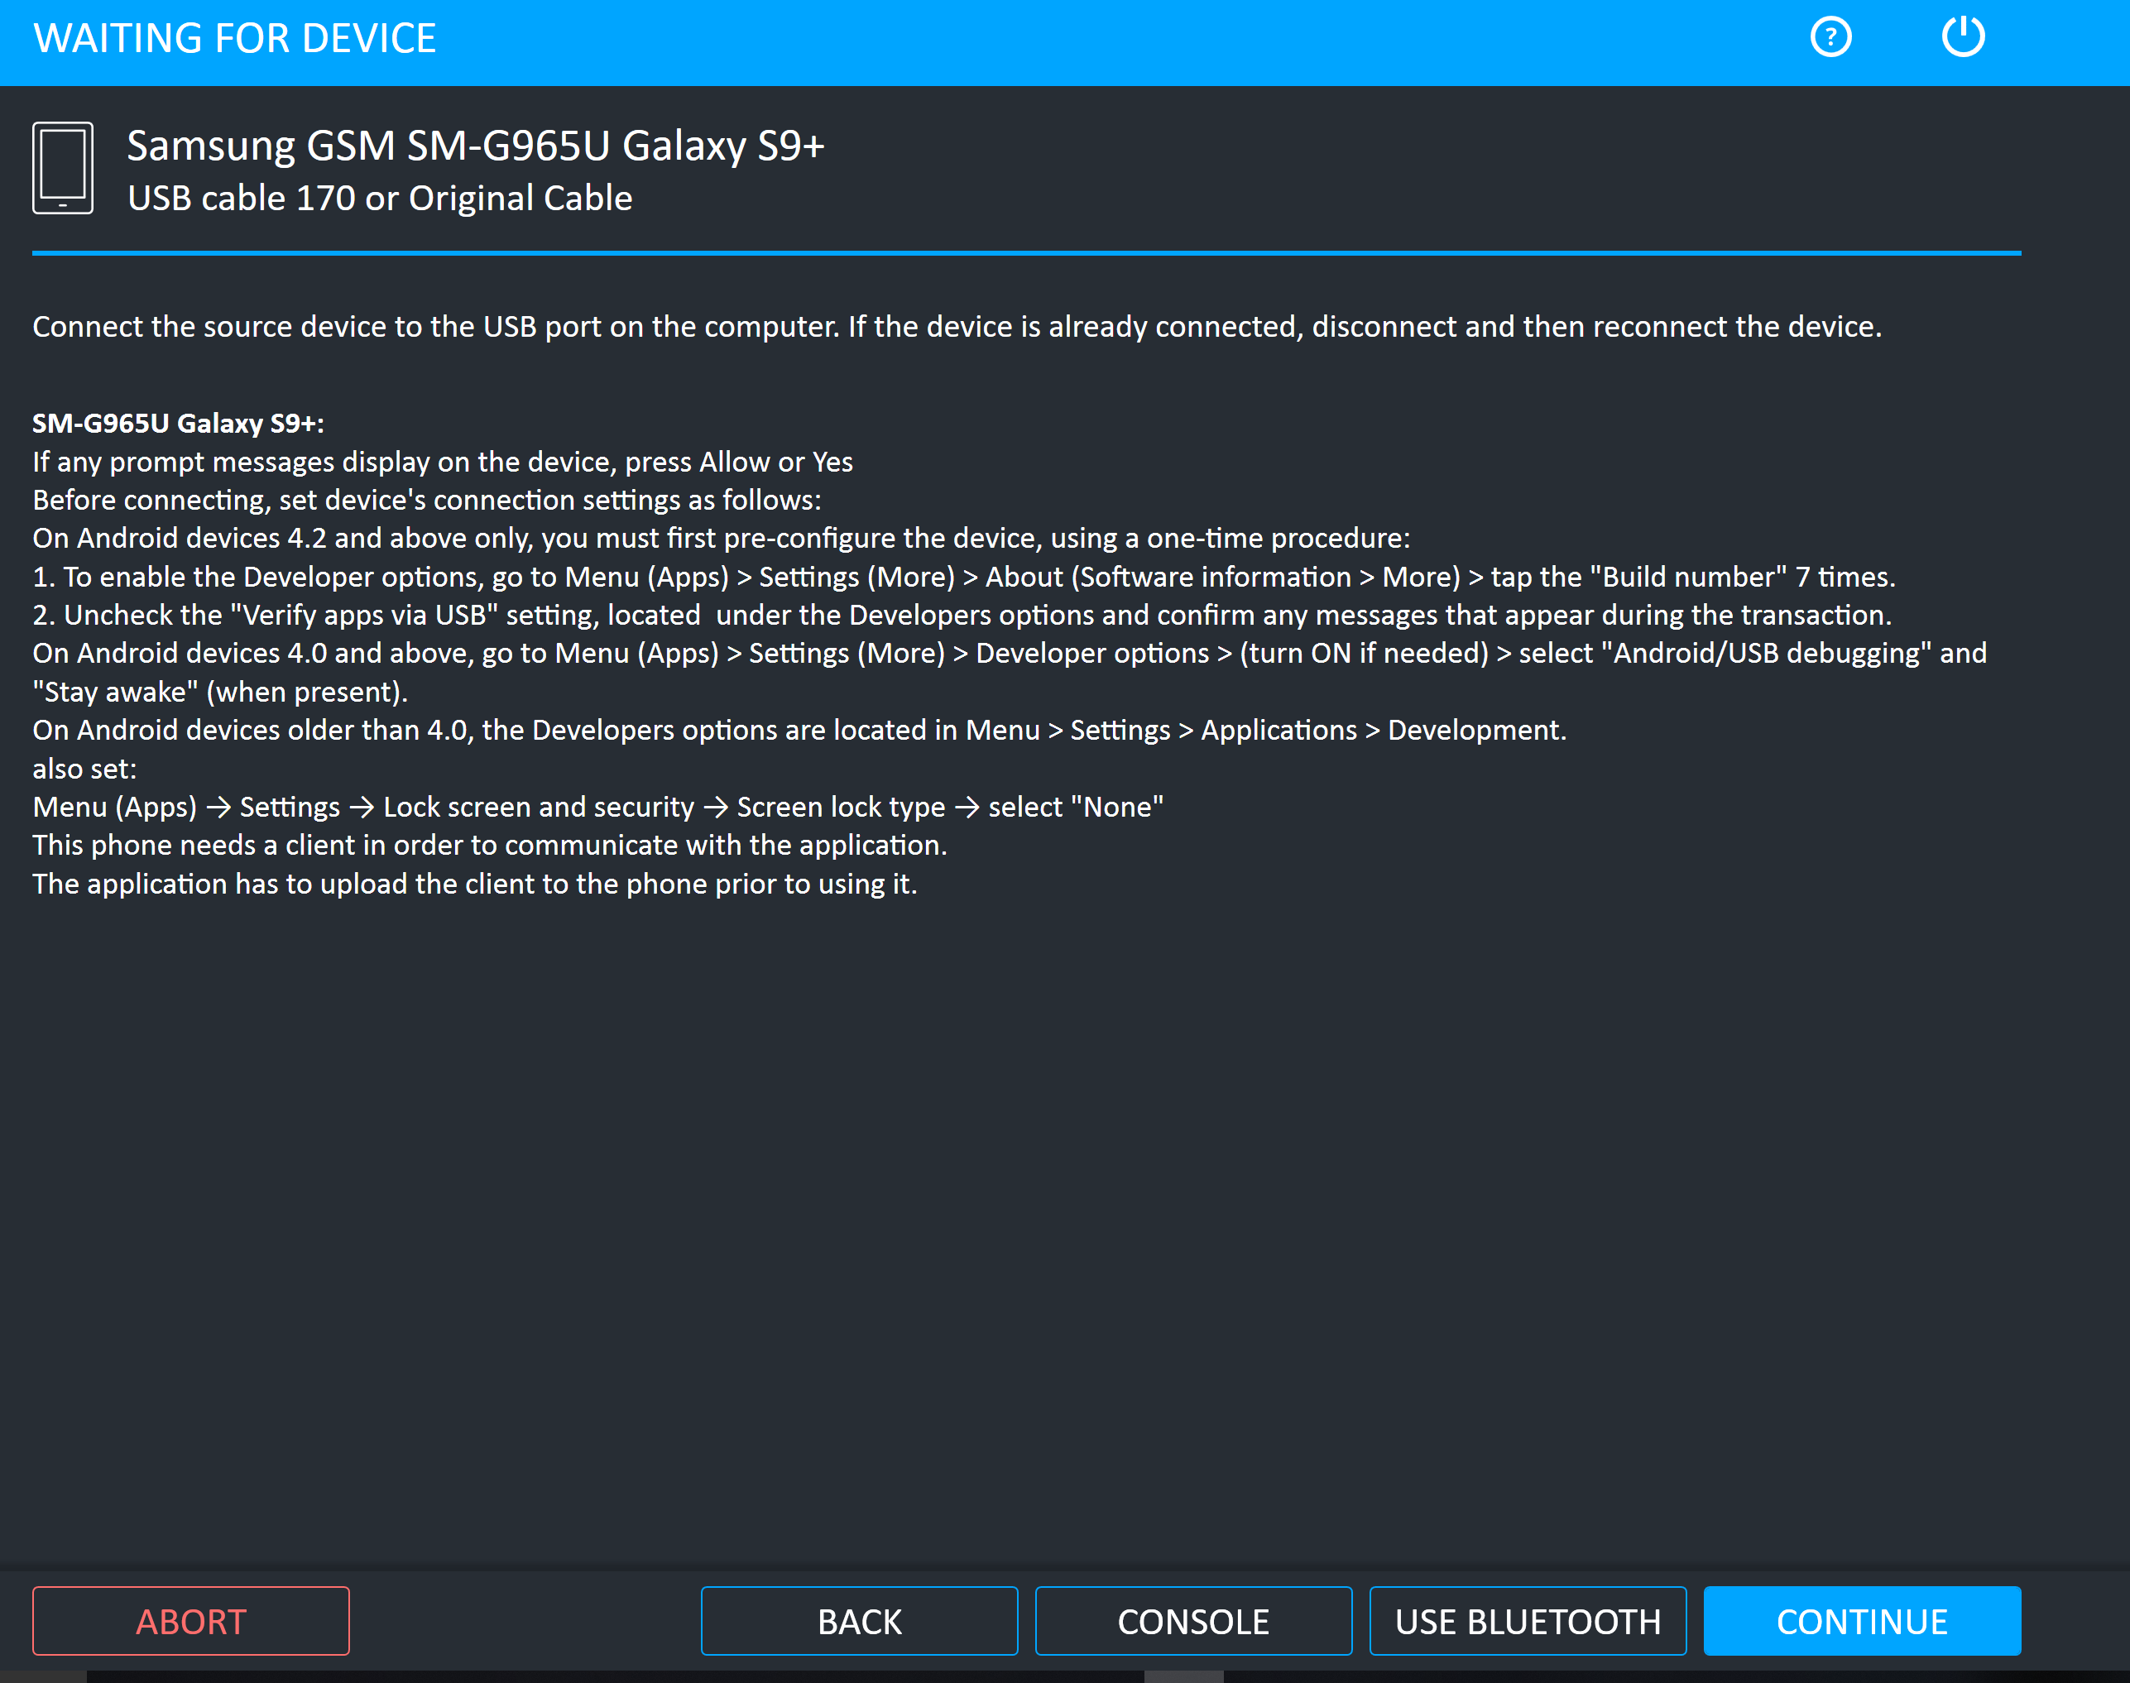
UFED 4PC

Slide 14
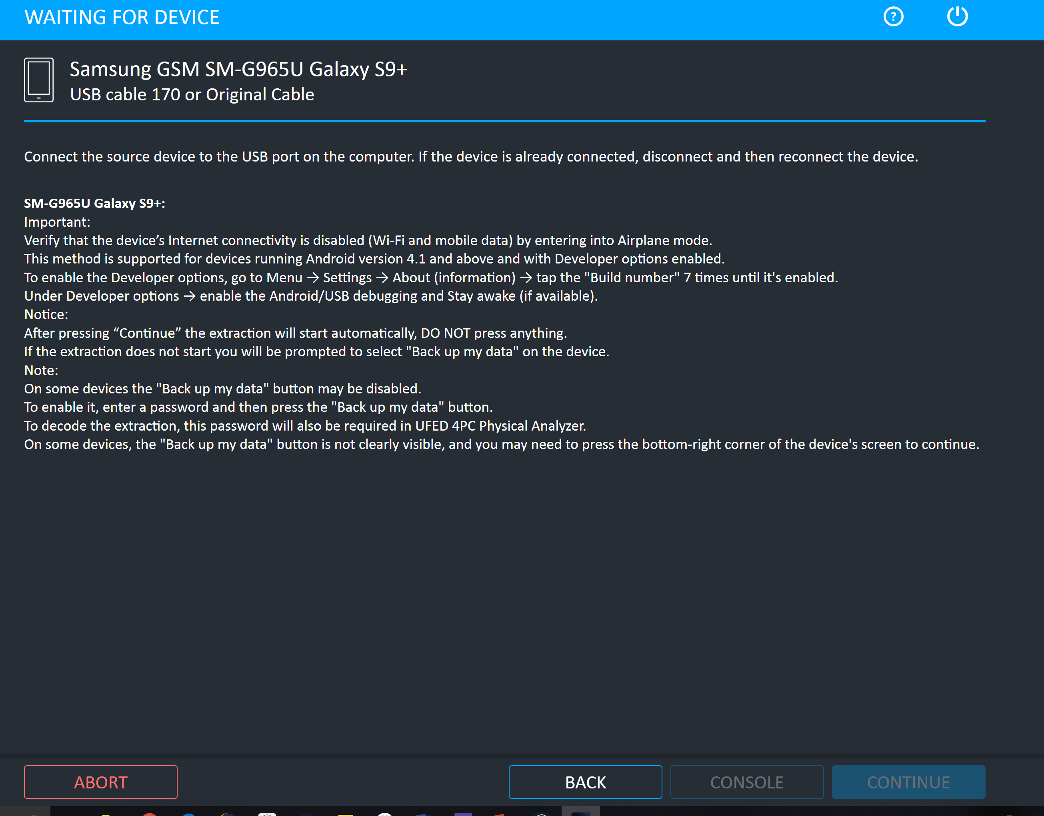
UFED 4PC

Slide 15
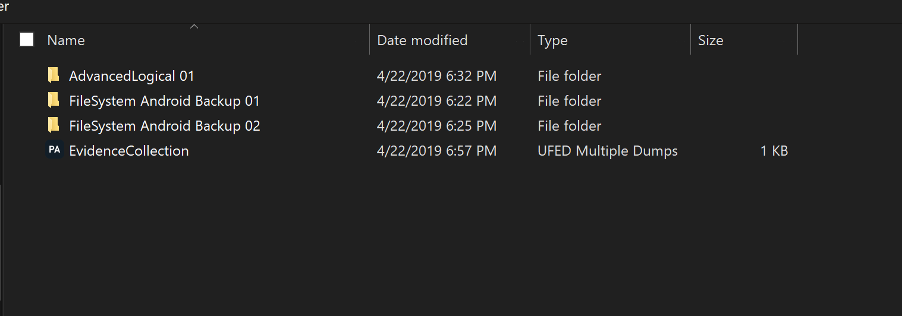
UFED 4PC

Slide 16
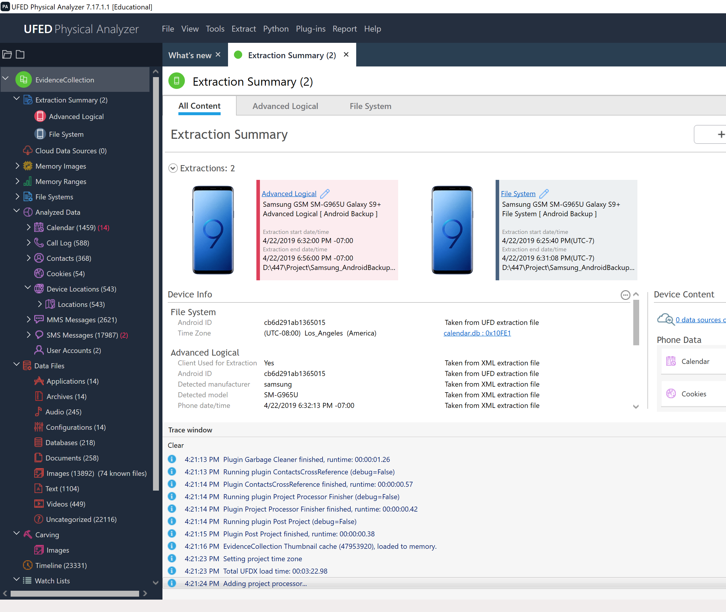
UFED Physical Analyzer

Slide 17
UFED 4PC: What was acquired?
What was?
What wasn’t?
Device file system
Configurations, databases, applications, archives
Device media
Audio, videos, text
Device attachments
Images, videos
Application data
Memory image
Redundant if device was powered off
Can find malware here though
Deleted files
Files that I recently deleted were not present
Was not able to see device partitions or specifics of how the device data is structured

Slide 18
Magnet Axiom
According to the User Guide, for Android 2.1 and newer, Axiom can obtain physical images from rooted devices and “quick” images from non-rooted devices
“quick” being a logical image that contains user data and some native application data
Attempts to acquire Galaxy S9 failed
Device was not detected

Slide 19
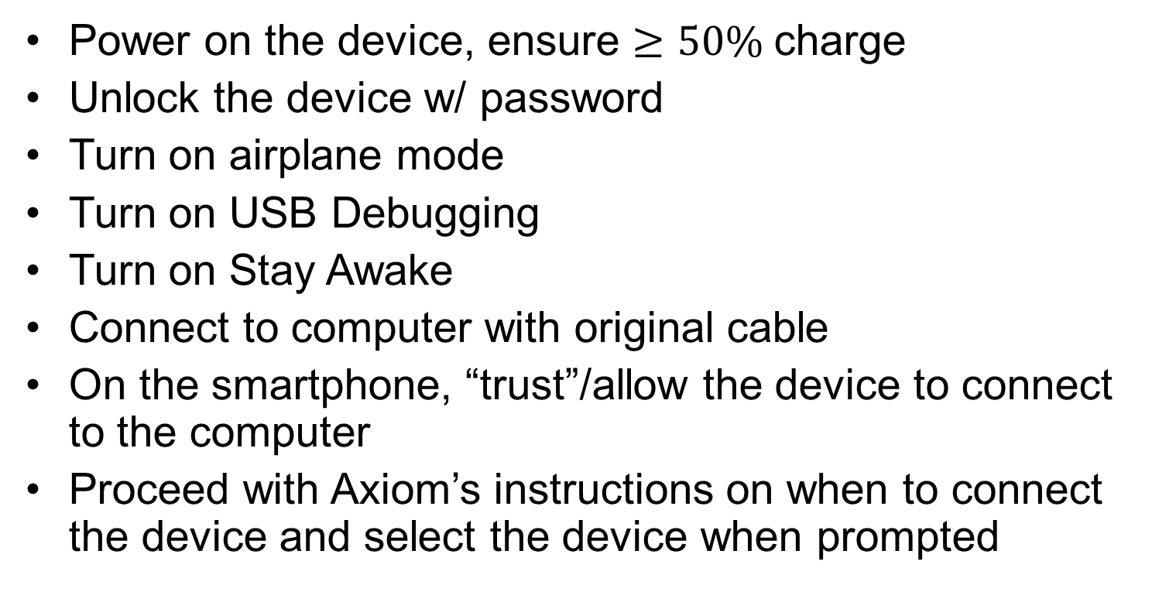
Magnet Axiom: Steps Taken
Power on the device, ensure $≥50\%$charge
Unlock the device w/ password
Turn on airplane mode
Turn on USB Debugging
Turn on Stay Awake
Connect to computer with original cable
On the smartphone, “trust”/allow the device to connect to the computer
Proceed with Axiom’s instructions on when to connect the device and select the device when prompted

Slide 20
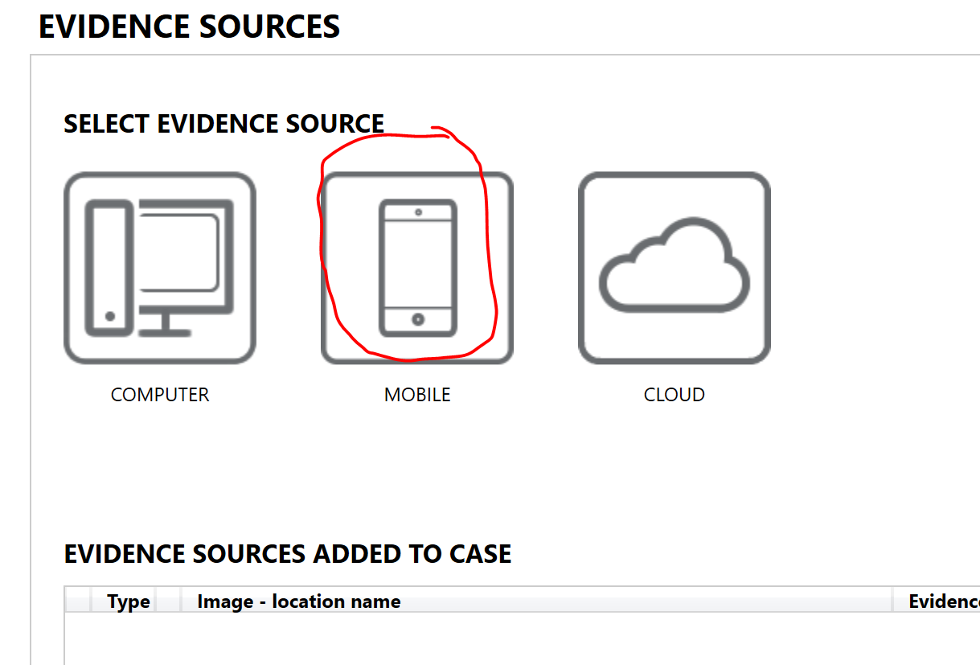
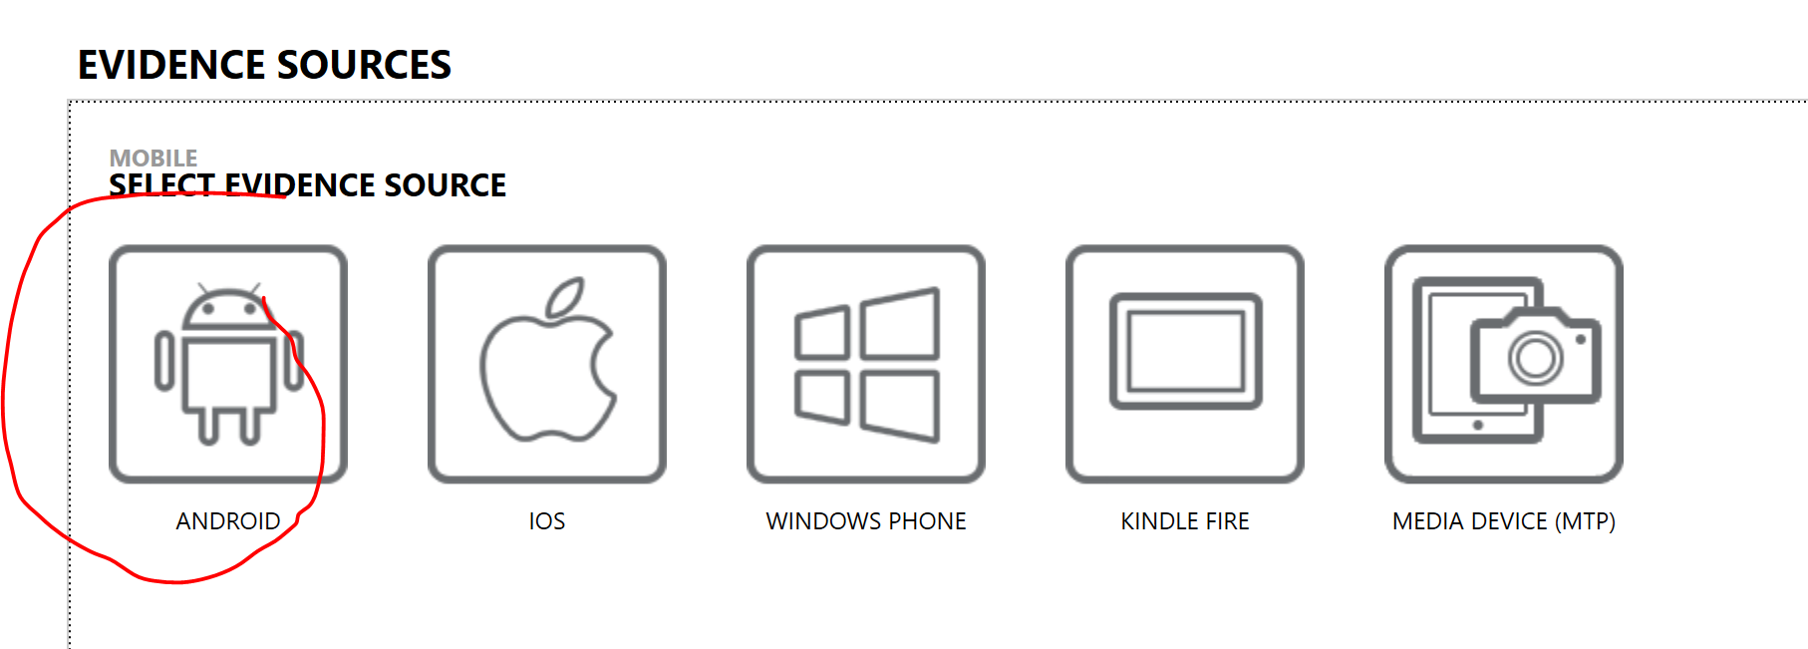
Magnet Axiom

Slide 21
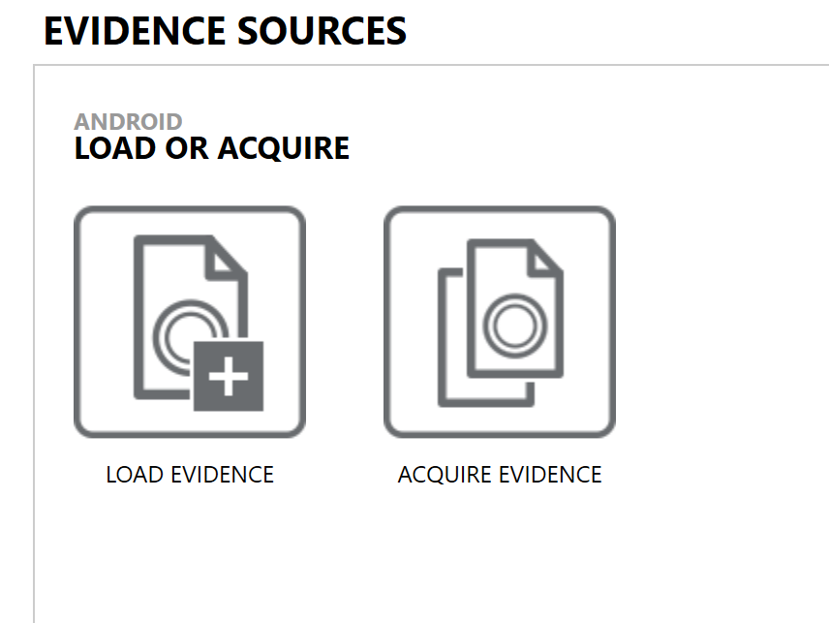
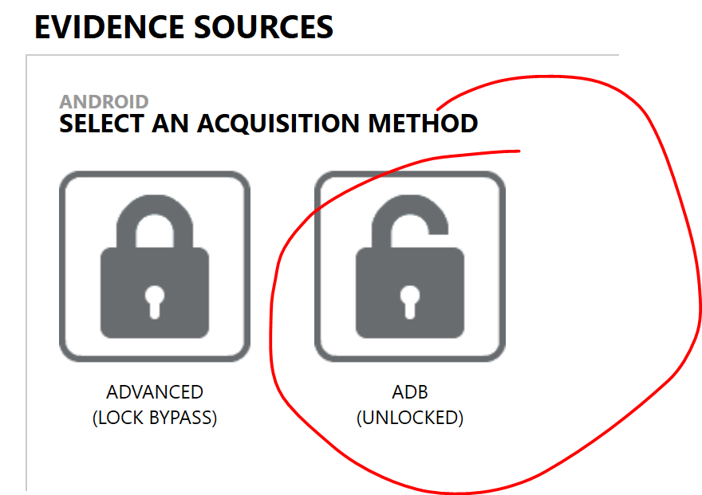
Magnet Axiom

Slide 22
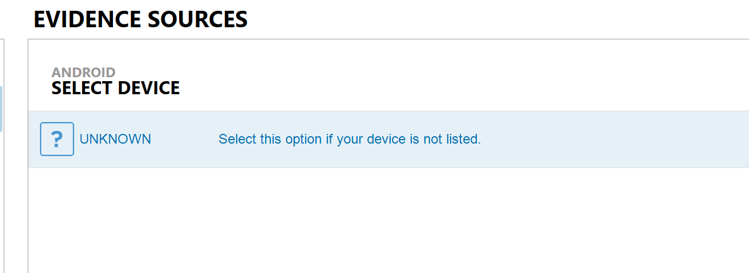
Magnet Axiom

Slide 23
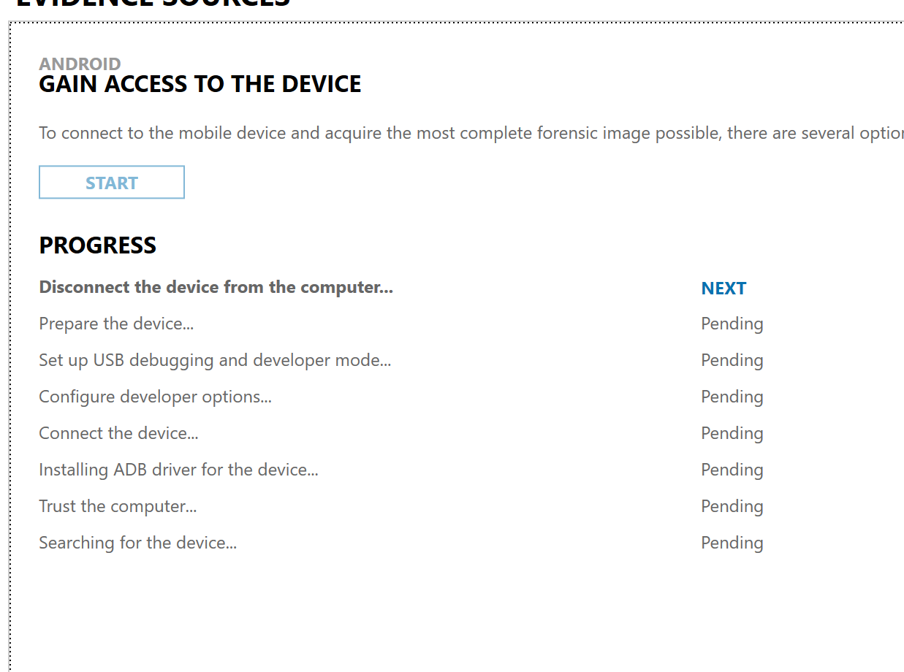
Magnet Axiom

Slide 24
Blacklight
Mobilyze is BlackBagTech’s mobile forensics software that supports Android acquisitions
It DOES NOT currently support Android version 9, therefore it cannot acquire updated Galaxy S9’s
Supports Android devices running 4.0.4 to 8.0
All without encryption

Slide 25
Oxygen
Supports Physical Extraction, ADB (FileSystem) backup extraction, and Agent extraction (Logical)

Slide 26
XRY
They offer services (“Access Services”) to LEO and other agencies to access S9, decrypting, unlocking, and extracting them
XRY supports physical and logical extractions of latest android versions including many standard applications such as Facebook, WeChat, WhatsApp, etc.

Slide 27
Rooting
Will allow for a full physical image to be taken
“Officially” only the Exnyos chipset variant of the Galaxy S9/S9+ is supported by the root
Model numbers SM-G965F/FD/N/X and SM-G960F/FD/N/X are supported
Snapdragon variants are not supported
Will wipe the entire device…
Usually this is a viable option if the user has already rooted their own device
Excellent guide here:
https://www.thecustomdroid.com/samsung-galaxy-s9-plus-root/

Slide 28
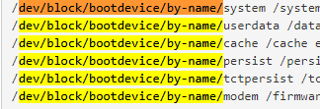
Viewing partitions of rooted device with ADB tool

